Slide 1




STUDENT DROPOUT ANALYSIS
TEAM MEMBERS
1. SANJAY S (210701231)
2. SHRIRAM KUMAR A N (210701247)

Slide 2


Abstract
Increasing concerns over student dropout rates necessitate innovative approaches to identify at-risk students and implement effective interventions. This presentation explores the use of data-driven analysis and machine learning techniques to predict student dropout, enabling early identification and targeted support. By leveraging insights from dropout analysis, educational institutions can develop proactive strategies to improve student retention and success. The presentation discusses the significance of dropout prediction, the methodology used, and the potential impact on educational outcomes

Slide 3

Gathering Data
Downloading the dataset from open sources like Kaggle etc and use that after importing certain important libraries like numpy,pandas,seaborn,matlotlib etc
# Loading the dataset using pandas dataframe
import pandas as pd
import numpy as np
import matplotlib.pyplot as plt
import seaborn as sns
import warnings # Ignore warnings warnings.filterwarnings("ignore")
data = pd.read_csv('/content/dropout (1).csv')

Slide 4
Data Preprocessing
Cleaning the data by handling missing values, encoding categorical variables, and scaling numerical features.
# Encoding categorical variables
from sklearn.preprocessing import LabelEncoder
le = LabelEncoder()
for name in data.columns:
if data[name].dtype =='object':
data[name] = le.fit_transform(data[name])

Slide 5
Feature Engineering
Exploring and using necessary features that may enhance the predictive power of the model.
from sklearn.tree import DecisionTreeClassifier
from sklearn.feature_selection import SelectFromModel
from sklearn.model_selection import train_test_split
X_train, X_test, y_train, y_test = train_test_split(X, y, test_size=0.2, random_state=5)
model = SelectFromModel(DecisionTreeClassifier())
model.fit(X_train, y_train)
model.get_support()
selected_feat= X_train.columns[(model.get_support())]

Slide 6
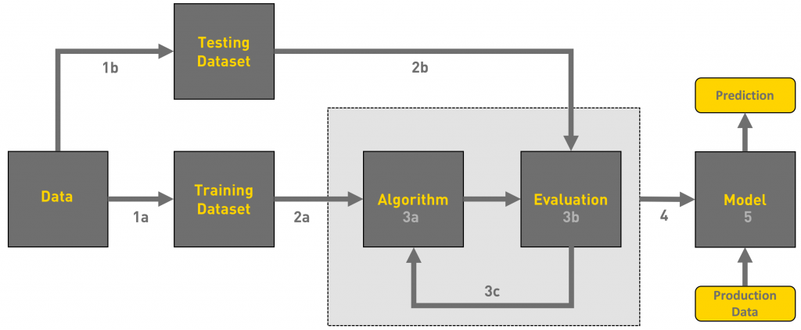
Model Training
Train your selected model on the training data.
# Spliting the data into features (X) and target variable (y)
X = data.drop('dropout', axis=1)
y = data['dropout']
# Spliting the data into training and testing sets
from sklearn.model_selection import train_test_split
X_train, X_test, y_train, y_test = train_test_split(X, y, test_size=0.2, random_state=42)

Slide 7
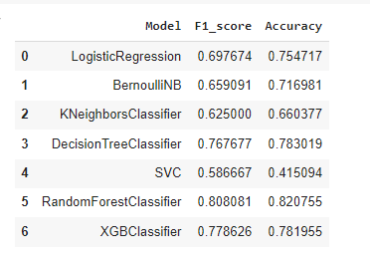
Model Selection
Exploring various models for training the data
#RandomForestClassifier model
from sklearn.ensemble import RandomForestClassifier
model = RandomForestClassifier()
model.fit(X_train, y_train)

Slide 8
Model Evaluation
Evaluating the trained model using appropriate evaluation metrics.
# Making predictions on the test set
y_pred = model.predict(X_test)
from sklearn.metrics import accuracy_score
accuracy = accuracy_score(y_test, y_pred)

Slide 9

Deployment
Deploying the trained model into production where it can be used to make predictions in real-time.
# Save the trained model
from joblib import Parallel, delayed
import joblib
rf.feature_names = list(selected_feat)
joblib.dump(rf, 'model.pkl')
joblib.dump(le, 'encoder.pkl')

Slide 10

Advantages/Use of Analysis
Early Intervention
01
Identifying at-risk students early and providing timely support to prevent dropout.
02
Resource Allocation
Allocating resources like counseling and academic support programs based on dropout risk factors.
03
Improved Student Success
Using analysis findings to develop targeted interventions and programs for student retention.

Slide 11
THANK YOU

